Slide 1
HPE Private Cloud AI
Idea to impact in record time
Speaker name and title
Date

Slide 2



Expanded AI factory portfolio from HPE
for every AI ambition, across clouds, cores and countries
Turnkey AI factory
Private Cloud AI
Enterprises
AI factory at scale
Model builders & SP’s
Sovereign AI factory
Governments, public sector
Common control plane: HPE Morpheus and HPE OpsRamp
Turnkey, engineered systems
Customized, validated solutions
Infrastructure | Software | Services | Ecosystem | Sustainability
Notes:
Intent of Slide: Introduce our AI factory portfolio and its differentiation
The AI factory for Every Ambition
Our AI factory portfolio offers a range of solutions from a completely turnkey offering for traditional enterprises to customized, validated solutions for model builders, service providers, and sovereigns. All provide fully integrated infrastructure, software, control plane and services guiding the user to value faster without the burden of navigating the stack and filling in the gaps on their own.
With a comprehensive platform delivering turnkey simplicity to composable flexibility, and supporting a wide variety AI workloads, HPE helps customers realize their AI vision, wherever they are on their journey
Background – what is an AI factory?
An AI factory is not a specific product—it is a blueprint for designing, building, and operating AI architectures and workflows to turn data into value. It draws on the metaphor of a traditional factory, where raw materials are transformed into finished goods through a structured production line. In this context, the “raw material” is data, and the “finished product” is AI-driven insights or applications.
The AI factory approach emphasizes repeatability, scalability, and governance across the entire AI lifecycle—from data ingestion and model training to deployment, monitoring, and continuous improvement. It provides a framework for operationalizing AI at scale through an integrated pipeline of infrastructure, software, and processes.

Slide 3
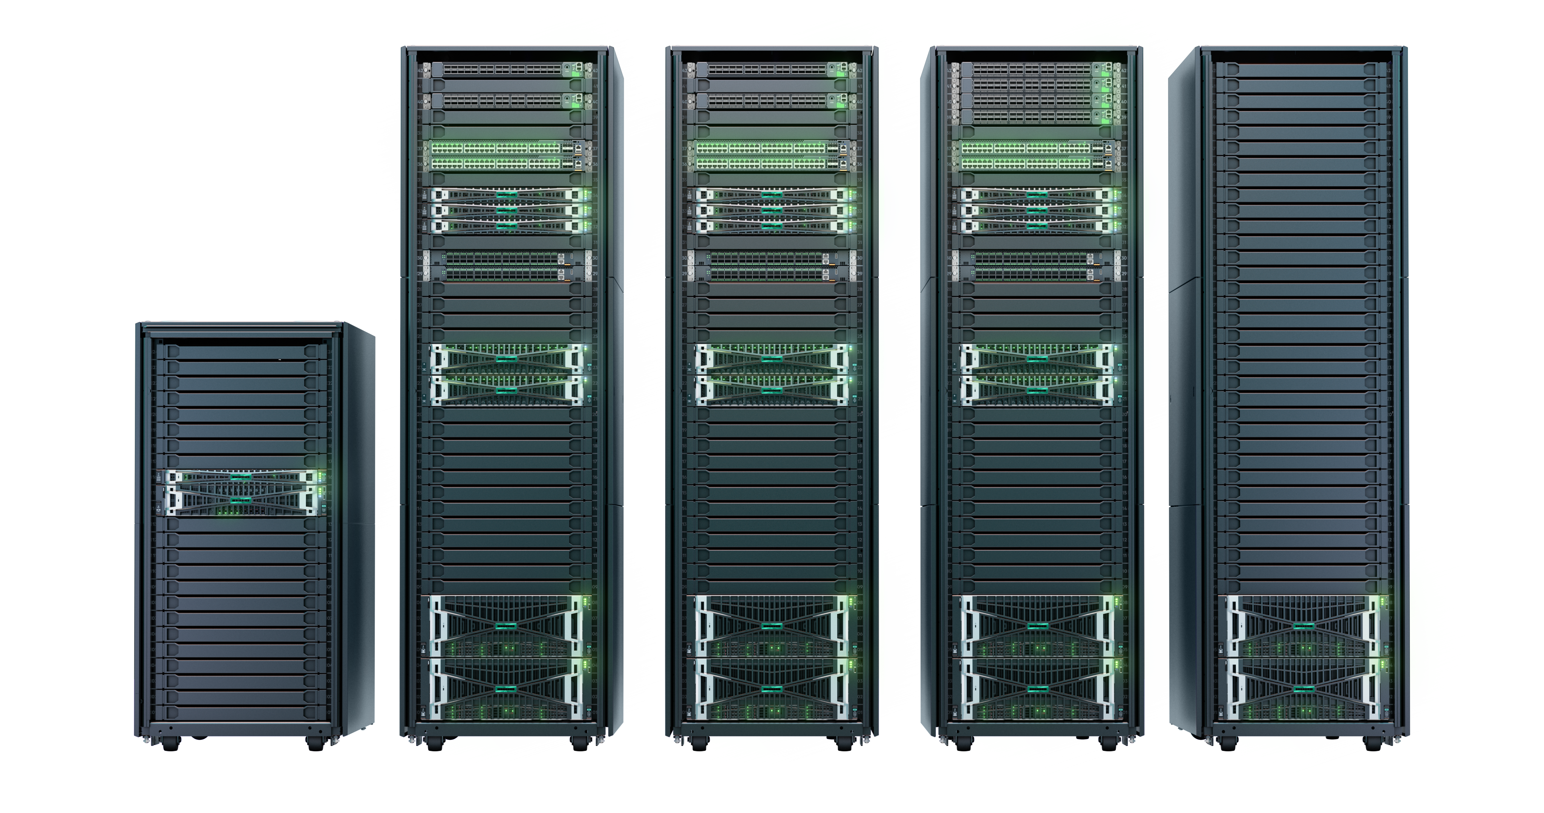
HPE Private Cloud AI
Engineered Turnkey AI Factory
Large
Fully-integrated, flexible, open stack ready to go
Optimized for AI performance in hybrid environments
Grow as needed, get the latest AI tech: scalable & expandable
Simplifies operations, management & security
Enables full control and compliance
Small
Medium
Expansion rack
Developer
(in rack)
Unified management experience
Up to 82% Lower TCO and Compared to Public Cloud over 3 years
Economic Validation: The economic benefits of HPE Private Cloud AI with NVIDIA AI Computing by HPE Enterprise Strategy Group 2025
Notes:
We know that every company's AI journey is different. That's why we don't offer a one-size-fits-all solution. Instead, HPE Private Cloud AI is available in four distinct form factors: developer, small, medium, and large. This allows you to select the exact starting point you need, whether you're running a proof-of-concept or a mission-critical, large-scale deployment.
The Best of Both Worlds: Ready-to-Go, but Flexible
What truly sets this solution apart is its dual nature. It's pre-configured for rapid deployment, so you can get up and running incredibly fast. But at the same time, it's extensively customizable to meet your unique business needs. This means you get a robust, ready-to-use foundation that significantly accelerates your AI initiatives, without sacrificing the flexibility to adapt and fine-tune your environment as you evolve.
Engineered for Unparalleled Performance
At the core of this platform is game-changing performance. We're powering HPE Private Cloud AI with HPE ProLiant Gen12 servers featuring the latest NVIDIA GPUs, including the Hopper H200 NVL and Blackwell ProX6000. This combination supercharges everything from traditional AI to cutting-edge agentic AI use cases, creating an unparalleled foundation for all your AI ambitions.
Seamless, Non-Disruptive Scaling
We've also completely simplified the scaling process. Unlike traditional deployments that require complex network redesigns, you can grow your HPE Private Cloud AI system (excluding the developer model) by simply plugging an expansion rack directly into the base unit. This expansion capability works across different compute generations and GPU architectures, giving you a clear, long-term growth path and ensuring your AI infrastructure can evolve as AI itself evolves. We currently have these expansion racks for our medium and large configurations, with shipments starting in August.
Absolute Security for Critical Environments
For organizations where security is non-negotiable, we've introduced an air-gapped HPE Private Cloud AI solution. This addresses the critical need for absolute isolation in sectors like government, defense, and finance. It allows for private AI model customization and inference with zero external network exposure. This air-gapped configuration is currently available in a medium form factor, with plans to expand to others based on customer demand. Our initial focus for Q4 is US federal organizations and the DoD.
The Power of an Integrated Software Stack
Finally, built into the solution is a smart software layer of curated AI tools and models that are fully maintained and supported by HPE. This isn't just hardware; it's a complete ecosystem. It includes built-in machine learning inference and workflow software, a model registry, and out-of-the-box support for NVIDIA AI Enterprise and Blueprints. You can also easily import external ISV apps and models, giving your teams the freedom to use the tools they prefer within a secure, managed environment.
This solution reduces risk by replacing complex integration cycles with an engineered and validated solution that works out of the box.
It protects investment with an optimized platforms designed to evolve with the latest advancements in AI
A self-service experience delivers agility and empowers innovation by removing the bottleneck of waiting for IT to provision infrastructure
Automated processes accelerate time-to-value providing customers with a fully operational solution in one day or less.

Slide 4

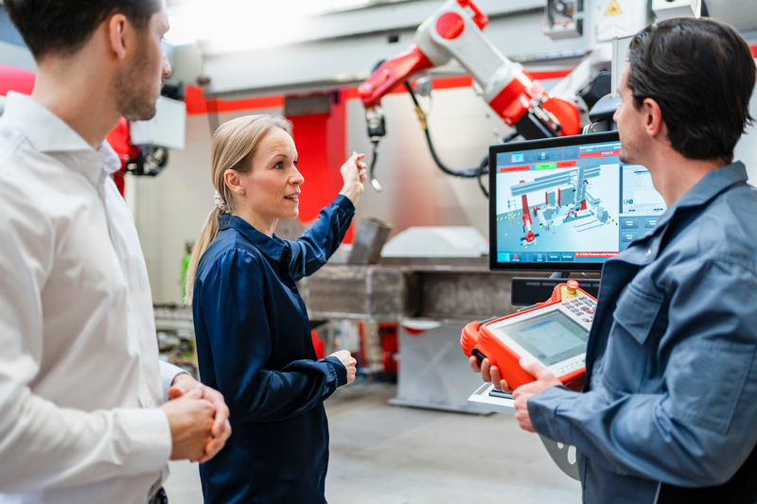
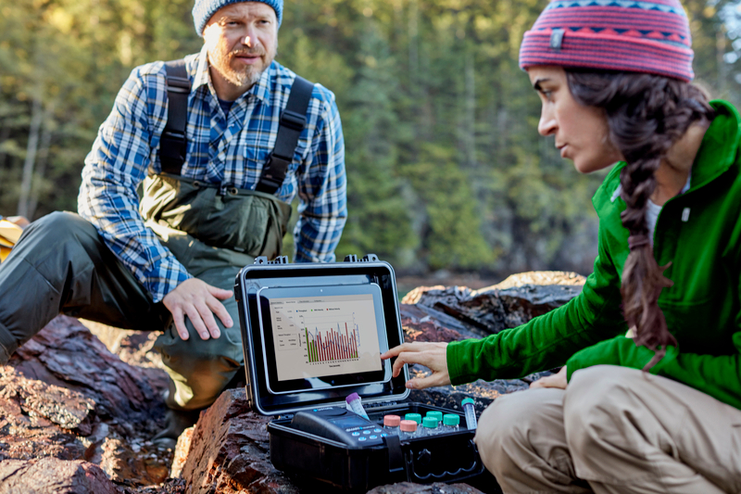
Driving business value through AI at scale
Administrators – IT
Data Engineers & Data Analysts
Data Scientists & ML Engineers
Deliver underlying AI infrastructure
Proactively manage critical AI assets
Establish fine-grained control over resources
Data for AI Success
Transform data from disparate sources into robust pipelines
Prevalidated hardware ensures component interoperability
Build and deploy AI solutions
Experiment, train, and deploy ML models and AI apps without worrying about tools and infrastructure.
⁴
Notes:
This slides segments the value by the target personas of HPE Private Cloud AI/AI Essentials.

Slide 5
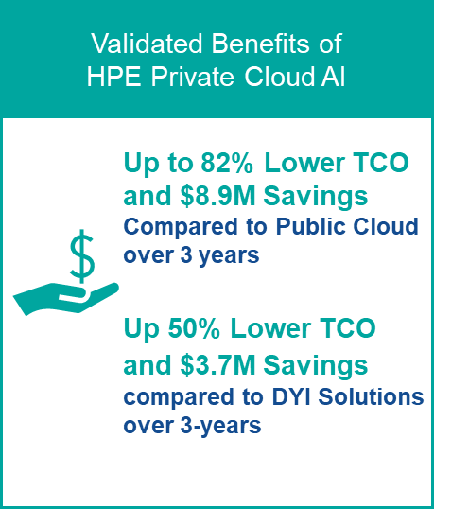
HPE Private Cloud AI
Compared to public cloud and DIY
Potential savings and key benefits:
Easier to manage
  Reduces manual setup and IT resources
  More efficient infrastructure = reduced TCO
Faster AI deployment and agility
  Integrated tools and flexible architecture
  Accelerate workflows with pre-validated NVIDIA AI Blueprints
Enhanced security and compliance
  Zero-trust security
  Built-in governance & compliance tools
Learn more:
https://www.hpe.com/psnow/doc/a00146433enw

Slide 6



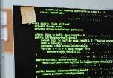

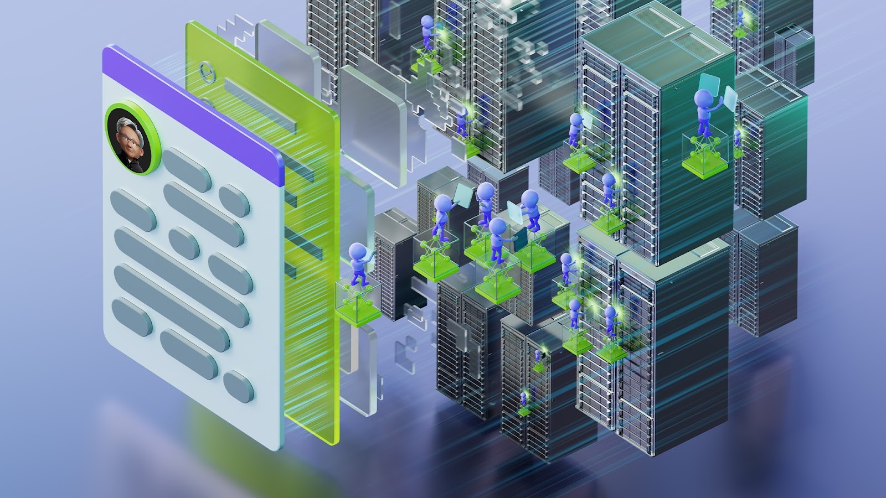




Real AI use cases – ready to deploy
AI-powered Vision Analytics
Agentic AI Customer Service
AI Traffic Report
AI Code Assistant
Onboarding Buddy AI Assistant
A faster, smarter way to extract meaning from visual data across operations.
Transform every customer interaction into an intelligent, compliant, and personalized experience!
From Chaos to Clarity: Real-Time Traffic Intelligence.
Imagine every line of code written faster, documented better, and kept secure, by an AI that never leaves your walls!
Turn onboarding from a burden into a competitive advantage!
Build an Intelligent AI Agent With the AI-Q NVIDIA Blueprint
Bulk Document Analysis
End to End Audio Conversational Agent
Live Stream Frame Analytics
Predictive Maintenance
Build AI agent interfaces to multimodal enterprise data that use tools and reason
Bulk document analysis that’s fast, private, and built for enterprise scale
Imagine every customer call answered instantly, by a voice that sounds human, responds intelligently, and keeps your data safe.
Turn you video streams into live intelligence! AI-powered frame analysis that converts any live camera feed into structured actionable insights.
See problems before they happen and fix them before they cost you!
Notes:
AI Solution Engineering Github - https://github.com/ai-solution-eng/ai-solution-demos
Agentic AI Customer Service - https://hpe.seismic.com/Link/Content/DCRTmJRP3DhX28HJ4bVjm2bqbXV3
Onboarding Buddy AI Assistant - https://hpe.seismic.com/Link/Content/DCg3CPDFmjDTVGcWjG4CV7fBmQHP
Predictive Maintenance - https://hpe.seismic.com/Link/Content/DC8JXJPcgDdMm8cPMHPWfFRQc2CB
AI Code Assistant - https://hpe.seismic.com/Link/Content/DCgpC89cqD432G4R7B3466gH8dpG
AI-powered Vision Analytics - https://hpe.seismic.com/Link/Content/DC6gbg4DqTPdM84HHcG2RjHRB3Rd
AI Traffic Report - https://hpe.seismic.com/Link/Content/DCjV87j438f9VGqBV4pd9QWjHqhB
Automatic Vessels Geometry Analysis and 3D Reconstruction - https://hpe.seismic.com/Link/Content/DCHGPF4FMfCjWG2R6XbXWXdhTVG3
End to End Audio Conversational Agent - https://hpe.seismic.com/Link/Content/DCQhGCJVgHTjJGTGhbG3B49fHRm8
Bulk Document Analysis - https://hpe.seismic.com/Link/Content/DCj7qVb6j4Pc787WqhCbF6JCDTQB
Live Stream Frame Analytics - https://hpe.seismic.com/Link/Content/DC6M7cHWRcP2V84CWP8TcpT4hMh8

Slide 7
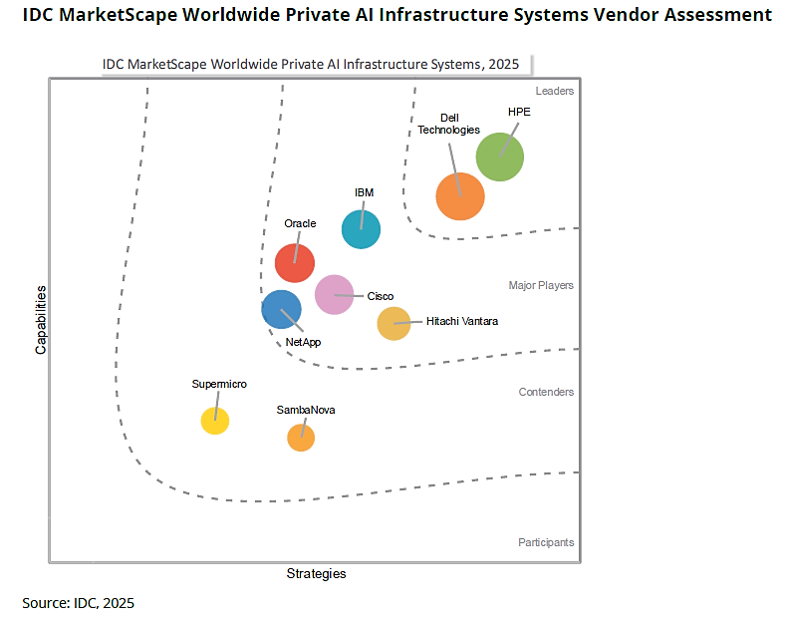
IDC MarketScape for AI Infrastructure Systems
HPE is positioned as a Leader in this 2025 IDC MarketScape for worldwide private AI infrastructure systems
“For customers that want a tightly integrated stack that includes robust storage and management integrations, the HPE Private Cloud AI reduces the complexity related to ensuring data pipelines and AI workloads are efficiently integrated.”
IDC, “IDC MarketScape: Worldwide Private AI Infrastructure Systems 2025 Vendor Assessment,” Doc# US53002625e, August 2025
IDC MarketScape vendor analysis model is designed to provide an overview of the competitive fitness of technology and suppliers in a given market. The research methodology utilizes a rigorous scoring methodology based on both qualitative and quantitative criteria that results in a single graphical illustration of each supplier’s position within a given market. The Capabilities score measures supplier product, go-to-market and business execution in the short-term. The Strategy score measures alignment of supplier strategies with customer requirements in a 3-5-year timeframe. Supplier market share is represented by the size of the icons.
Notes:
It's one thing for us to tell you how good our solution is. It's another for a leading industry analyst to validate it.
We’re incredibly proud to announce that HPE has been positioned as a Leader in the 2025 IDC MarketScape for Worldwide Private AI Infrastructure Systems.
This report confirms what we've been working toward. Let me highlight a few of the key takeaways from their analysis:
First, they validated our turnkey approach. IDC noted that our solution is 'tightly integrated and fully turnkey,' requiring 'little onsite integration to get the system up and running.' They recognized that our model dramatically reduces the complexity and time it takes to get to value.
Second, they called out our full-stack integration and management. The report highlights that our 'integrated, full-stack automation, observability, and security functions are enabled via the HPE GreenLake hybrid cloud operations platform.' This means our solution isn't just a collection of parts; it's a unified platform that's simple to manage from day one.
Third, they saw the value in our disaggregated storage architecture. IDC pointed out that our design allows customers to 'scale compute and storage independently.' This is critical for AI, where your data and compute needs don't always grow at the same rate, giving you unmatched flexibility and cost control.
And finally, they recognized our deep experience. They pointed to HPE's 'long history of working with high-performance computing and liquid cooling systems,' which is a huge advantage for customers who are concerned about the power and thermal constraints of modern AI.
This report isn’t just a badge of honor for us; it’s independent confirmation that the HPE Private Cloud AI solution is the simplest, fastest, and most trusted path for any enterprise serious about bringing AI into production.

Slide 8
Thank You
Speaker name and title
Date

